Slide 1
19CSE211
Term2 - Multi Cycle Data Path
Session3 – Concluding Session

Slide 2

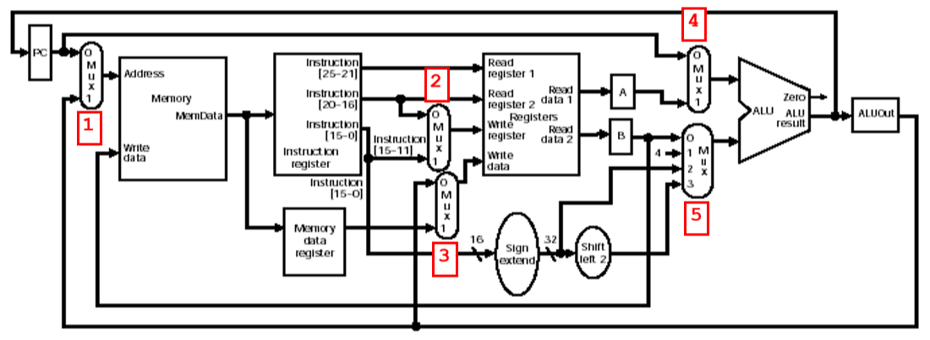

Slide 3
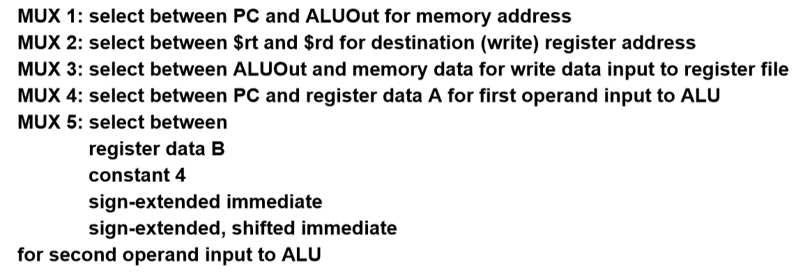

Slide 4


Slide 5
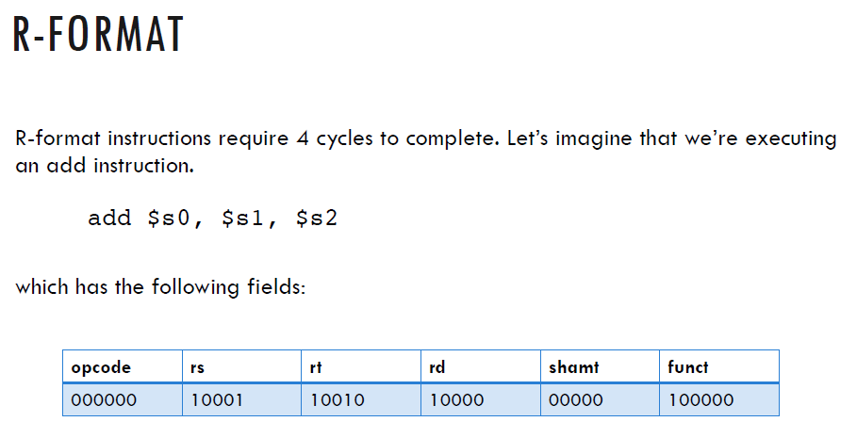

Slide 6
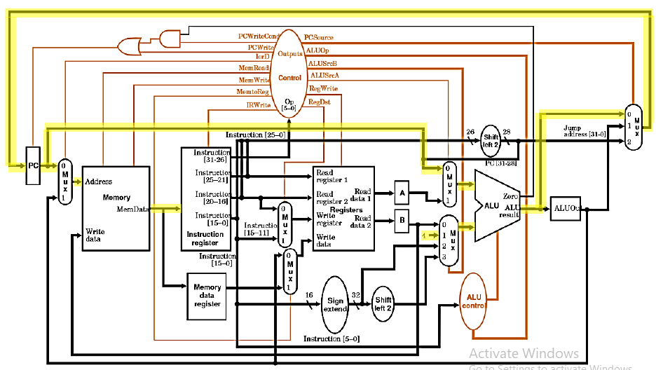
R Format Cycle I

Slide 7
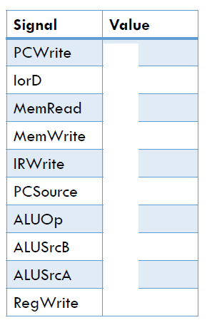

Slide 8
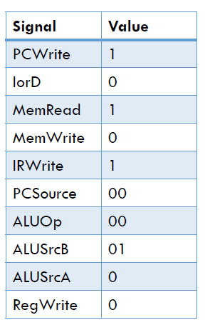

Slide 9
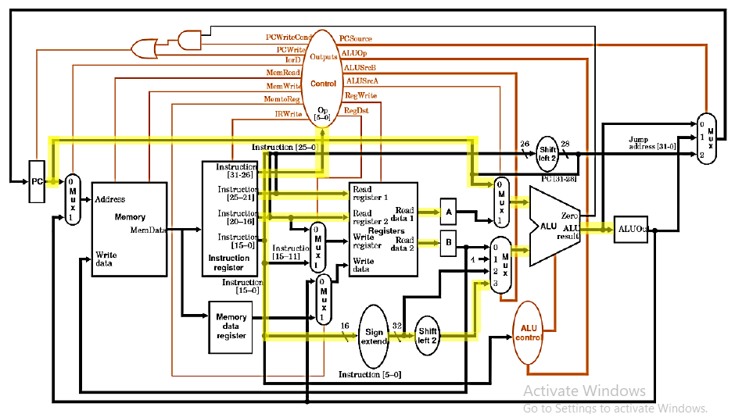
R Format Cycle II

Slide 10
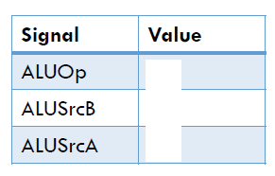
R Format Cycle II

Slide 11
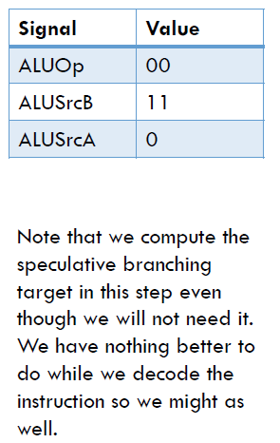
R Format Cycle II

Slide 12
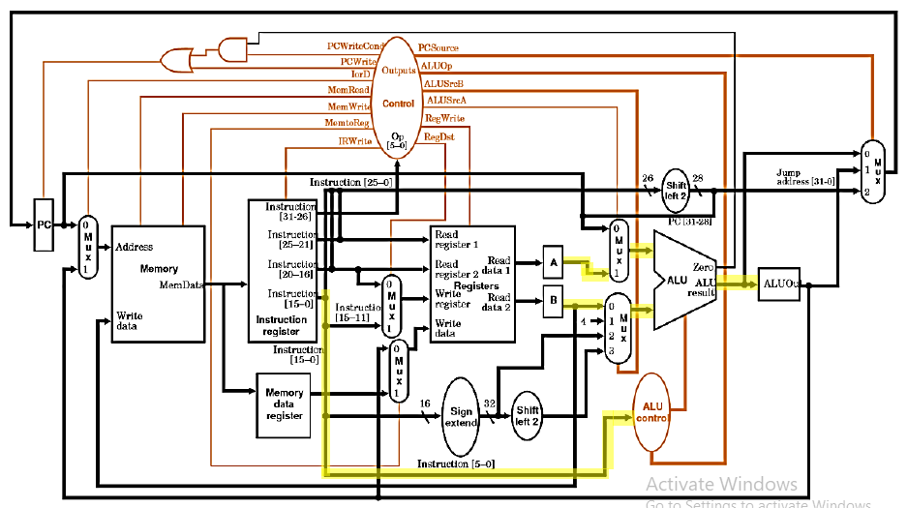
R Format Cycle III

Slide 13
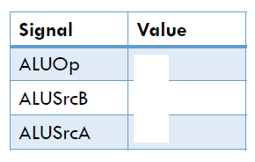
R Format Cycle III

Slide 14
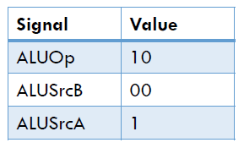
R Format Cycle III

Slide 15
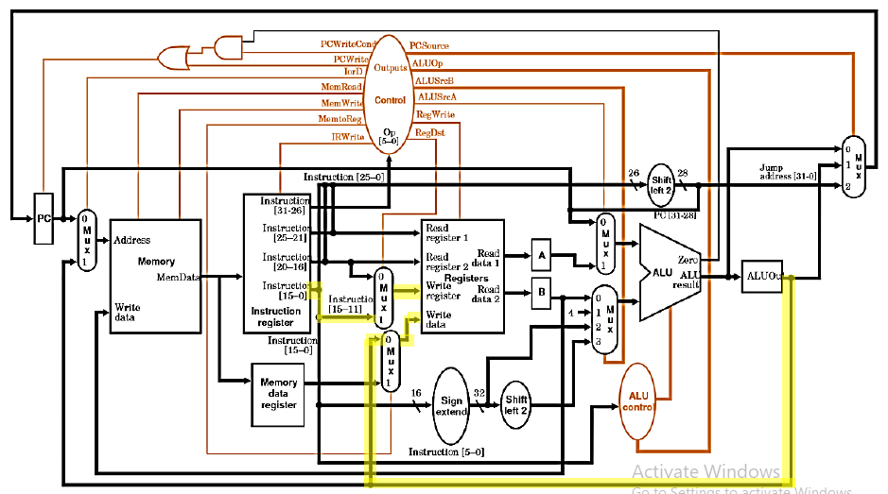
R Format Cycle IV

Slide 16
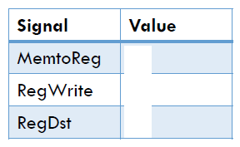
R Format Cycle IV

Slide 17
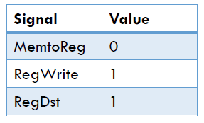
R Format Cycle IV

Slide 18
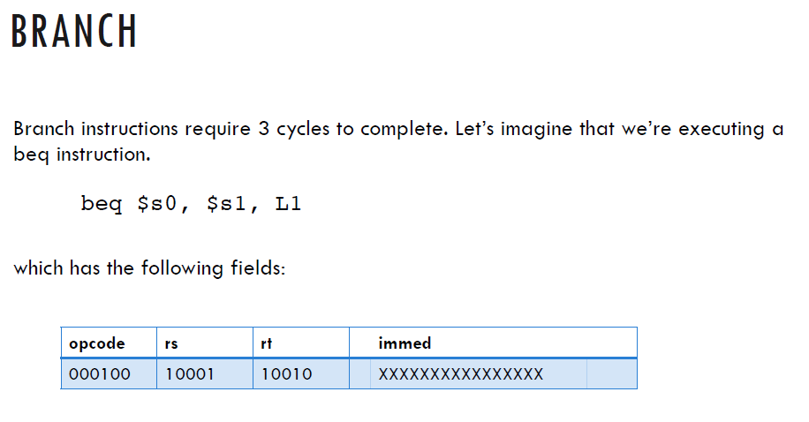

Slide 19

Branch Format Cycle I

Slide 20
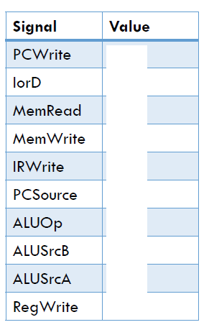
Branch Format Cycle I

Slide 21
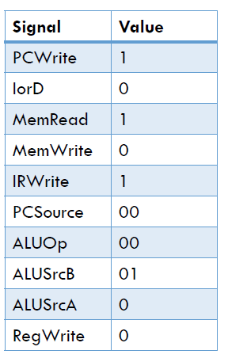
Branch Format Cycle I

Slide 22
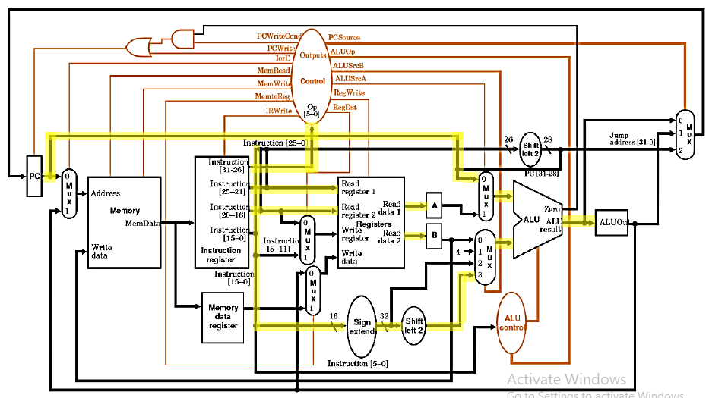
Branch Format Cycle II

Slide 23
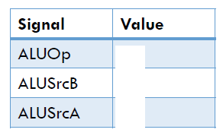
Branch Format Cycle II

Slide 24
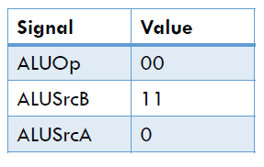
Branch Format Cycle II

Slide 25
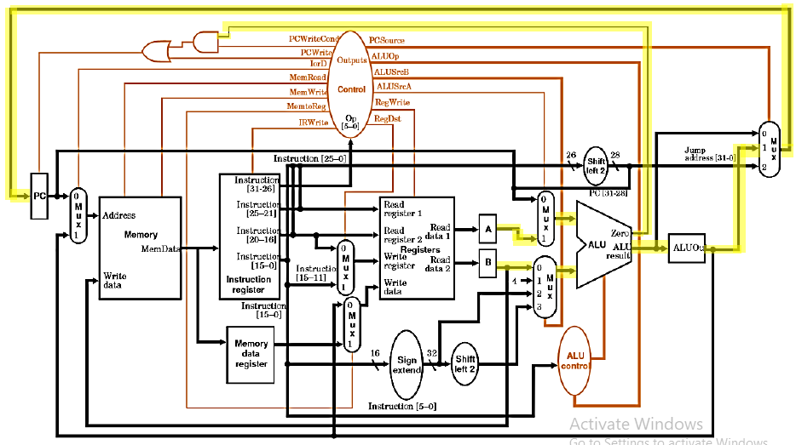
Branch Format Cycle III

Slide 26
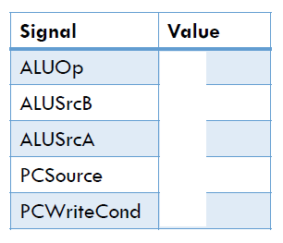
Branch Format Cycle III

Slide 27
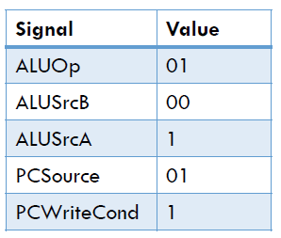
Branch Format Cycle III

